Slide 1

Mini Project-2 (ID-202BP) Even Semester Session 2024-25
Image Generator
Presented by:
Prince Kumar (202410116100149)
Priyanshi (202410116100153)
Priyanshu Kansal (202410116100155)
Rahul (202410116100157)
Project Supervisor:
DR. VIPIN KUMAR
(Professor)

Slide 2
Introduction
Image generation in Java is a powerful capability that allows developers to create, manipulate, and render images programmatically. Using libraries like Java AWT (Abstract Window Toolkit) and Java 2D API, developers can draw shapes, apply colors, add text, and generate complex graphics dynamically. Additionally, Java supports Buffered Image, which enables image processing, transformations, and exporting in formats like PNG and JPEG. For advanced applications, frameworks like JavaFX and OpenCV provide enhanced graphics rendering and image processing capabilities. Whether for data visualization, graphic design, or automated image creation, Java offers a robust set of tools for image generation.

Slide 3
Objectives of Image Generation
Understand the basics of image creation and manipulation in Java.
Explore Java libraries like AWT, Java 2D, and JavaFX for image processing.
Demonstrate coding techniques for generating and modifying images.
Showcase real-world applications in design, gaming, and automation.
Optimize performance for efficient image handling in Java.

Slide 4
Literature Review of Image Generation
Java AWT & Java 2D API – Fundamental libraries for drawing shapes, rendering text, and handling image files.
JavaFX – Provides advanced graphical capabilities, better rendering, and modern UI support.
OpenCV for Java – Used for complex image processing, filtering, transformations, and computer vision.
Performance & Optimization – Research highlights efficient memory management and rendering techniques for better image generation.
Integration with AI & ML – Studies explore the use of Java for automated image creation and enhancement with artificial intelligence.
Real-World Applications – Java is widely used in game development, data visualization, and digital content creation.

Slide 5
Modules
Java Graphics Libraries – Covers essential libraries like AWT, Java 2D API, and JavaFX for creating and manipulating images.
Image Creation & Manipulation – Explains techniques for drawing shapes, adding text, applying colors , and modifying images dynamically.
File Handling & Formats – Focuses on saving, exporting, and loading images in formats like PNG, JPEG, and BMP.
Performance Optimization – Discusses memory management, rendering efficiency, and optimization techniques for smooth image processing.

Slide 6
Hardware & Software
Hardware Requirements
Processor – Intel Core i3/i5/i7
RAM – Minimum 4GB (Recommended: 8GB or more for handling large images).
Storage – At least 10GB of free space for development tools and generated images.
GPU (Optional) – Dedicated GPU (NVIDIA/AMD) for advanced graphics processing.
Software Requirements
CPU: Intel i3/i5/i7 or AMD equivalent
RAM: Minimum 4GB (Recommended 8GB+)
Storage: 10GB+ free space
GPU (Optional): For advanced graphics

Slide 7
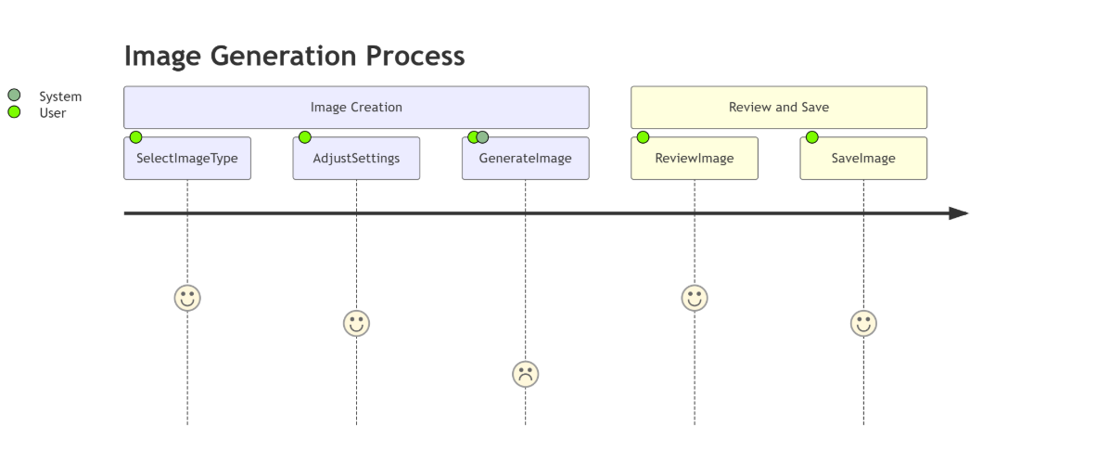

Slide 8
Workflow for Image Generator
Requirement Analysis – Define purpose and select necessary Java libraries.
Setup Environment – Install JDK, choose an IDE, and add libraries (AWT, Java 2D, JavaFX).
Image Creation – Use Buffered Image & Graphics2D to draw shapes, text, and colors .
User Input (Optional) – Allow customization via GUI (JavaFX/Swing).
Save & Export – Convert and save images in PNG, JPEG, or BMP format.
Testing & Optimization – Debug, improve performance, and enhance quality.
Deployment – Package for standalone or web-based use.

Slide 9
References for Image generator
"Java 2D Graphics" – Jonathan Knudsen
Covers Java 2D API, shapes, colors, and transformations for image generation.
"Core Java Volume I – Fundamentals" – Cay S. Horstmann
Provides a solid foundation in Java, including AWT and Swing for graphics.
"Java: The Complete Reference" – Herbert Schildt
Comprehensive guide covering Java graphics libraries and image processing.
"Filthy Rich Clients" – Chet Haase, Romain Guy
Advanced graphics techniques using Java 2D and Swing for rich UI applications.

Slide 10
Web Resources
Oracle Java Documentation – Official guide on Java graphics and image processing.
https://docs.oracle.com/en/java/
Java 2D API Guide – Detailed explanation of Java’s 2D graphics capabilities.
https://docs.oracle.com/javase/tutorial/2d/
JavaFX Graphics & Media – Resources on JavaFX for advanced graphical applications.
https://openjfx.io/
OpenCV for Java – Image processing techniques using OpenCV in Java.
https://opencv.org/
Image IO API – Java’s built-in library for reading and writing images.
https://docs.oracle.com/javase/8/docs/api/javax/imageio/ImageIO.html

Slide 11
Features and Innovations
Java enables dynamic image creation, custom graphics rendering, and file exporting using Java 2D API, JavaFX, and Image IO. It supports user customization, filters, and performance optimization for smooth execution.
Innovations include AI-powered image processing, OpenCV integration for real-time effects, and cloud-based image generation. Java also supports vector graphics, 3D rendering, and automation, making it a powerful tool for modern image generation.

Slide 12
Conclusion
Java is a powerful tool for image generation, offering dynamic graphics, customization, and efficient file handling through Java 2D, JavaFX, and OpenCV. With innovations like AI integration, cloud rendering, and 3D graphics, Java continues to evolve, making it a reliable choice for modern image processing applications.

Slide 13
Thank You !

